Slide 1

Multimedia Data Management
Lecture 6 – Django Introduction
Fall 2022

Slide 2
Django is a free and open-source web framework.

Slide 3
Creating Django Projects
$ conda install django
$ django-admin startproject <name>
$ django-admin startapp <name>
Notes:
Each project has several apps which stands for modules

Slide 4
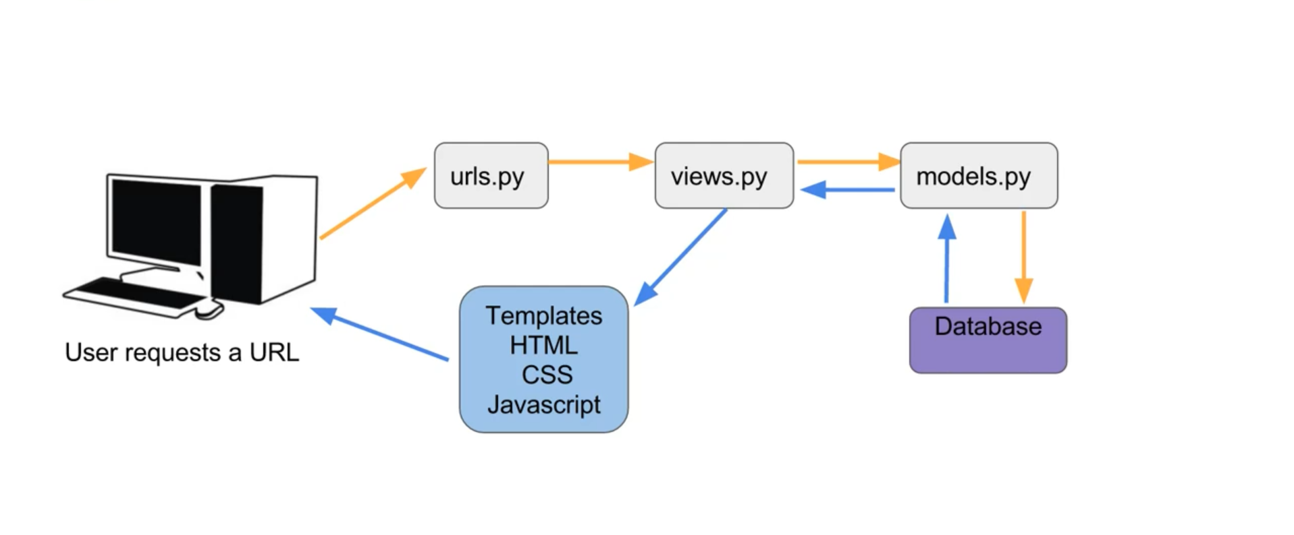
Django Project Management
Django follows MTV design pattern.
Notes:
Design pattern is a general repeatable approach to develop solutions for software engineering problems.
We need scalability, modularity, and isolation.

Slide 5
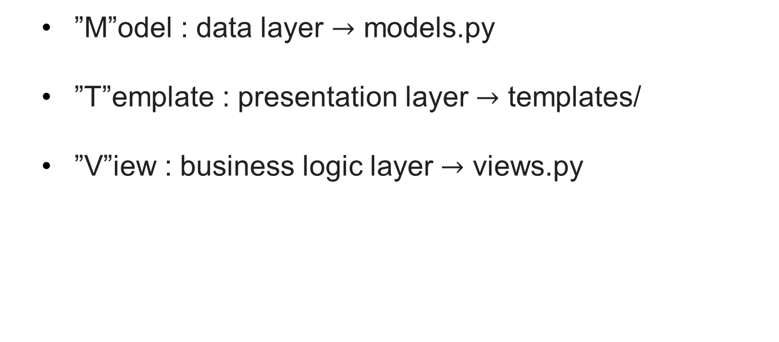
Django Project Management
”M”odel : data layer $→$ models.py
”T”emplate : presentation layer $→$ templates/
”V”iew : business logic layer $→$ views.py
Notes:
Design pattern is a general repeatable approach to develop solutions for software engineering problems.
We need scalability, modularity, and isolation.

Slide 6
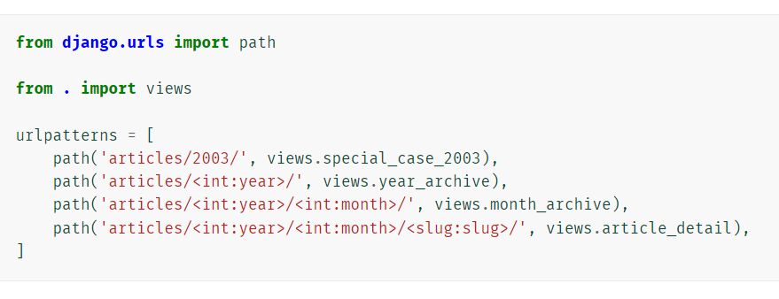
Django URLs
We design the routing of our web project in urls.py

Slide 7
A view, is a Python function that takes a web request and returns a web response. The view itself contains whatever arbitrary logic is necessary to return that response.

Slide 8
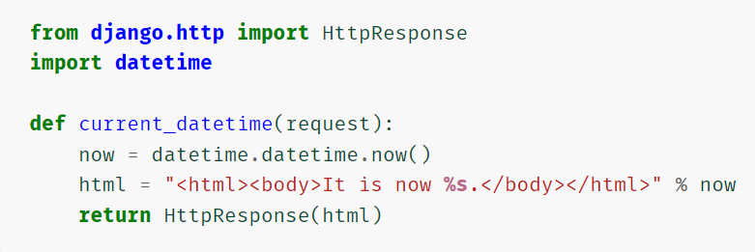
Django Views
How to write a view to return current date and time as an HTML document:

Slide 9
Django Shortcut Functions
These functions/classes introduce controlled coupling for convenience’s sake.
render
redirect
get_object_or_404

Slide 10
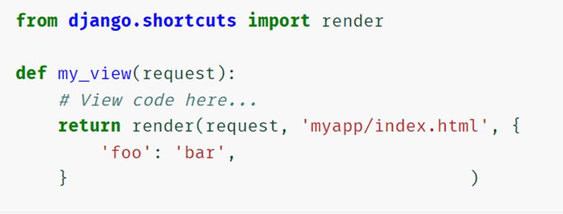
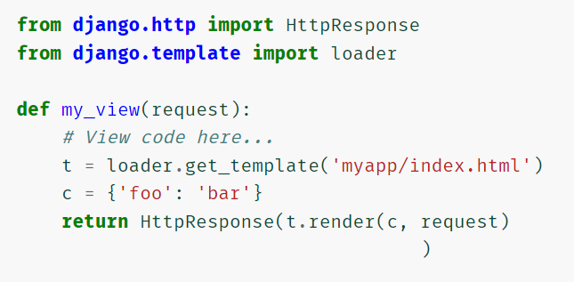
Django render() Shortcut

Slide 11
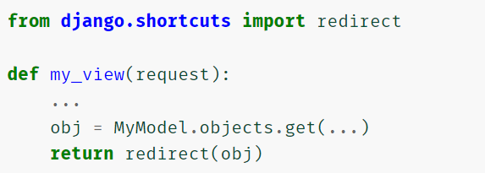
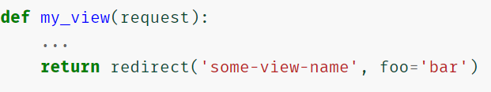
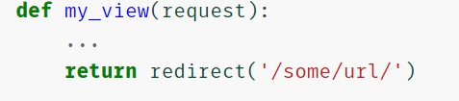
Django redirect() Shortcut
Notes:
The last one also works with full URLs:

Slide 12
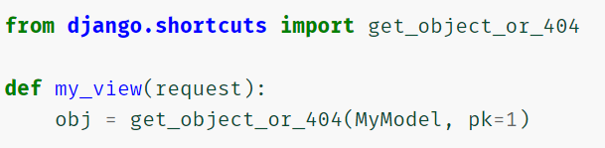
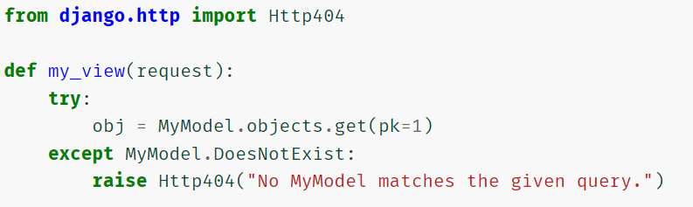
Django get_object_or_404() Shortcut

Slide 13
A model is the single, definitive source of information about your data. It contains the essential fields and behaviors of the data you’re storing. Generally, each model maps to a single database table.

Slide 14
Database to Models
We develop python classes for tables
Each class has several attributes for columns
We create instances as records
** Use singular names for Python models

Slide 15
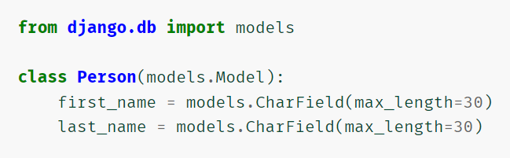
Django Models
Assume that we want to develop a model which defines a Person, having a first_name and last_name:

Slide 16
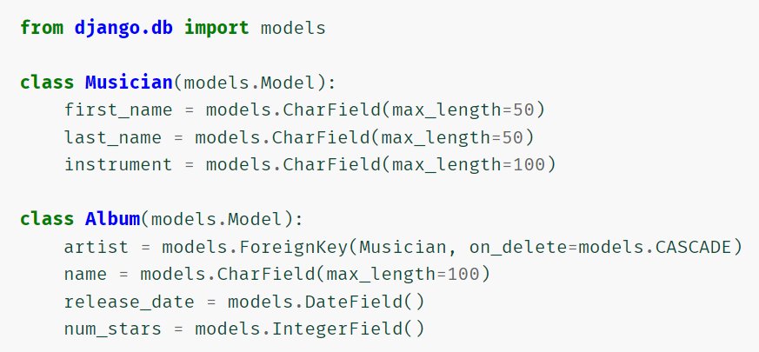
Django Models - Attributes
The most important part of a model – and the only required part of a model – is the list of database fields it defines.
https://docs.djangoproject.com/en/4.1/ref/models/fields/#model-field-types
Notes:
This is called abstraction, that hides what we don’t need to know.

Slide 17
Django Models - Attributes
There’s a set of common (optional) arguments available to all field types.
null: if True, Django will store empty values as NULL in the database. Default is False.
blank: if True, the field is allowed to be blank. Default is False.
default: the default value for the field.
primary_key: if True, this field is the primary key for the model.
unique: if True, this field must be unique throughout the table.
https://docs.djangoproject.com/en/4.1/ref/models/fields/#common-model-field-options
Notes:
Note that this is different than null. null is purely database-related, whereas blank is validation-related. If a field has blank=True, form validation will allow entry of an empty value. If a field has blank=False, the field will be required.
If you don’t specify primary_key=True for any fields in your model, Django will automatically add an IntegerField to hold the primary key, so you don’t need to set primary_key=True on any of your fields unless you want to override the default primary-key behavior.

Slide 18
A Django template is an HTML file injected with Python string marked-ups. Those constructs are recognized and rendered by the template engine.

Slide 19
Templates - Variables
Variables are surrounded by {{ and }} like this:
With a context of {'first_name': 'John', 'last_name': 'Doe’}, we will have:

Slide 20
Templates - Tags
Tags are surrounded by {% and %} like this:
We can develop our tags but there are tons of predefined tags also available.
https://docs.djangoproject.com/en/4.1/ref/templates/builtins/#ref-templates-builtins-tags

Slide 21

Templates - Filters
Filters transform the values of variables and tag arguments:
We can develop our filters but there are tons of predefined filters also available.
https://docs.djangoproject.com/en/4.1/ref/templates/builtins/#ref-templates-builtins-filters

Slide 22
Templates
Templates should be added as a directory to each app
Our project recognizes additional files via its setting.py
Template files can be treated as inheritable objects

Slide 23
HTTP Status Codes
Status Code | Description
200 | OK
301 | Moved Permanently
403 | Forbidden
404 | Not Found
500 | Internal Server Error
https://developer.mozilla.org/en-US/docs/Web/HTTP/Status

Slide 24
Project Files
manage.py: utility for interacting with project
python manage.py runserver
[project_name]/settings.py: settings and configuration

Slide 25
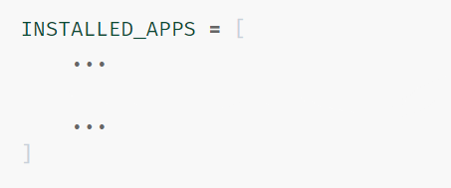
Django Settings
We should manually add our apps to INSTALLED_APPS list in settings.py:
python manage.py startapp main

Slide 26
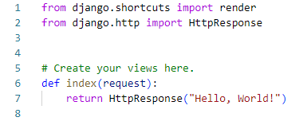
Django Functionalities
We know how to add function-based views to our apps:

Slide 27
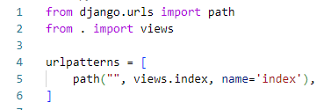
Django Routing
We manually add a urls.py file to our main app:
Notes:
We add names to reference them easier in other places of the project

Slide 28
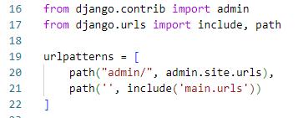
Link URL Configurations
Finally, we link app urls to the project urls.py:
Notes:
Now runserver will show hello world instead of the default screen

Slide 29

Use URL Parameters in Views
Let’s write a view to greet a certain person:

Slide 30
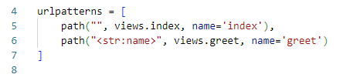
Use URL Parameters in Views
We should update main app urls.py:
Notes:
Now we runserver but there is a problem with the isolation of our project

Slide 31

Create templates Folder
There should be a folder called templates in each app.
Notes:
If you remember the MTV design pattern, we want to isolate representation from business logic (functionalities)
We can go without main and use index.html but we want to use namespace to make sure that the right file will be used.

Slide 32
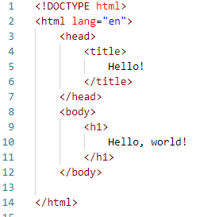
Create Html Files
Html files are developed using html tags:
Notes:
This is index.html

Slide 33

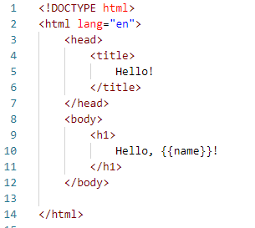
Update Views
Again, we isolate a view in views.py:
Then create a template for it.
Notes:
This is index.html

Slide 34

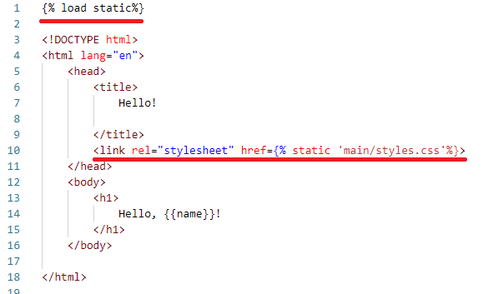
Static Files
By default, Django uses a folder called static for stylesheets and more.
Notes:
static/main/styles.css

Slide 35
References
https://www.djangoproject.com/
https://cs50.harvard.edu/web/2020/weeks/3/

